Slide 1
Advanced Biometric Identification Using U-Net for Iris Segmentation
Syed M. Ali Ashar (f2022376084)
Alisha Saleem (f2022376100)
University of Management and Technology, Lahore

Slide 2
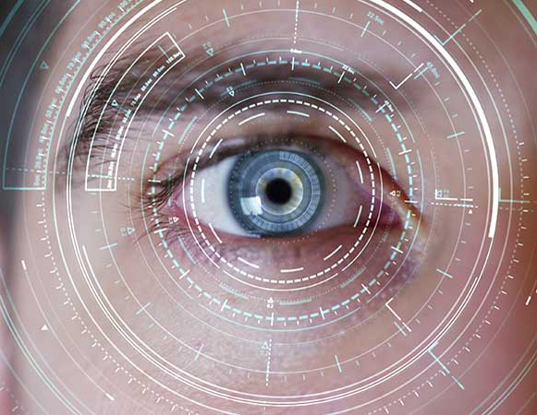
Introduction
Biometric systems leverage physiological traits for identification. Iris recognition is a highly accurate modality due to the stability and distinctiveness of iris patterns. This study aims to address challenges in iris segmentation using U-Net architecture.

Slide 3
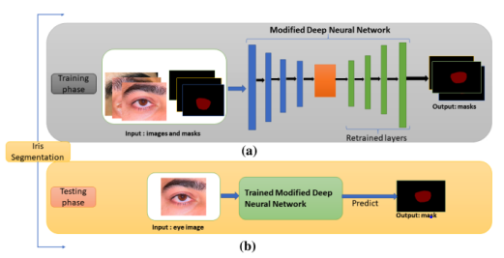
Problem Identification
Existing methods face challenges such as varying lighting, occlusions, and motion blur. Traditional algorithms lack robustness, and basic deep learning approaches often fail in edge cases.

Slide 4
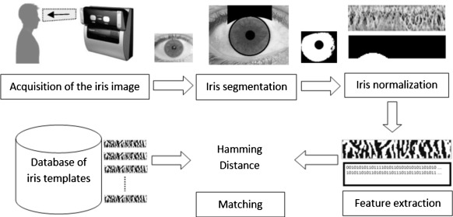
Objective and Approach
This research develops an advanced iris segmentation system using U-Net, focusing on accuracy, efficiency, and adaptability under diverse conditions.

Slide 5
Literature Review: Overview
Past studies explored traditional and deep learning approaches for iris segmentation. Challenges remain in handling non-ideal conditions and ensuring computational efficiency.

Slide 6
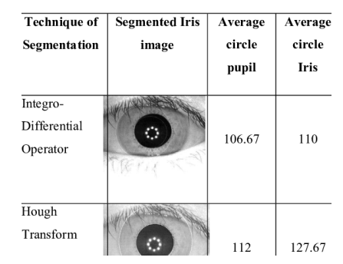
Literature Review: Traditional Methods
Traditional segmentation techniques like Daugman’s Integro-Differential Operator were effective but struggled under occlusion and varying lighting.

Slide 7
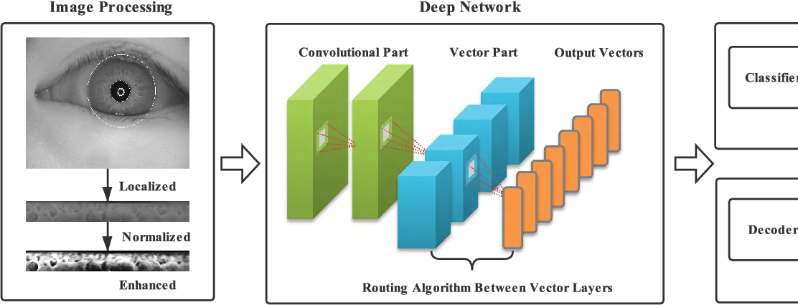
Literature Review: Deep Learning Methods
Deep learning methods, such as CNNs, have improved accuracy but are computationally intensive. U-Net addresses these limitations by maintaining spatial fidelity through skip connections.

Slide 8
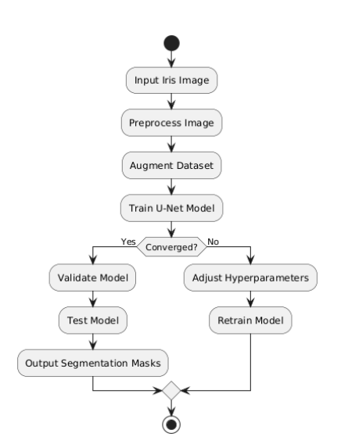
Methodology: Overview
The study employs U-Net architecture on the MMU1 dataset, emphasizing preprocessing, data augmentation, and robust training to enhance segmentation accuracy.

Slide 9
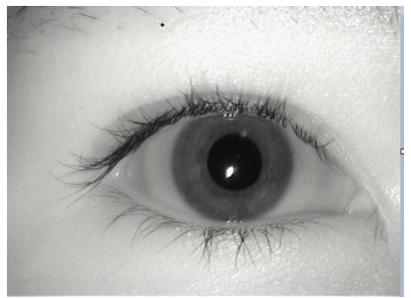
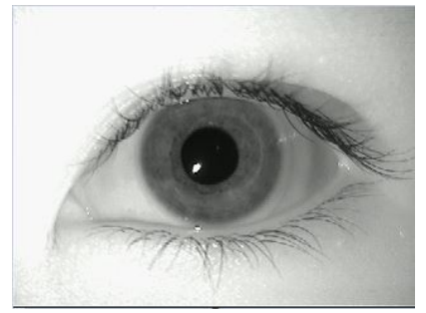
Dataset Description
The MMU1 Iris Dataset contains 920 images, with diverse imaging conditions. Images were preprocessed to standardize input dimensions and improve model training.

Slide 10
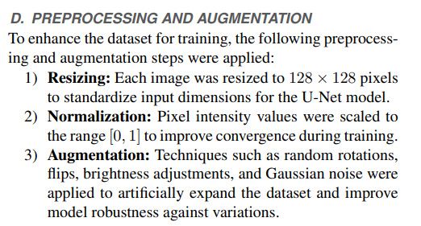
Preprocessing Techniques
Preprocessing included resizing images to 128x128 pixels, normalizing pixel intensities, and applying data augmentation techniques such as rotation and noise addition.

Slide 11
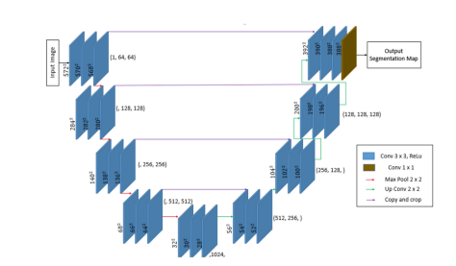
U-Net Architecture
U-Net consists of an encoder-decoder structure with skip connections to retain spatial information. Enhancements include additional convolutional layers and dropout to mitigate overfitting.

Slide 12

Training Parameters
The model was trained using a learning rate of 0.001, batch size of 32, and 30 epochs. The Dice coefficient loss function and Adam optimizer were employed for optimization.

Slide 13
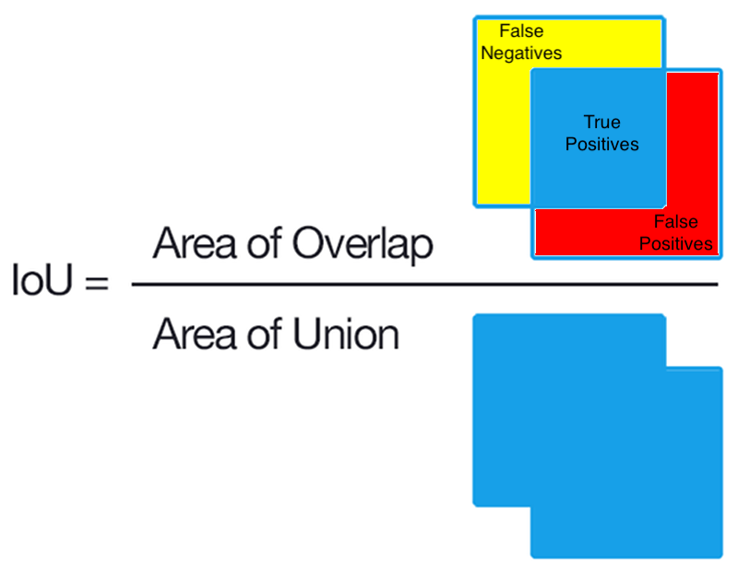
Validation Metrics
Metrics such as Dice Coefficient and Intersection over Union (IoU) were used to evaluate the accuracy and robustness of the segmentation model.

Slide 14

Results: Quantitative
The model achieved a Dice Coefficient of 0.92 and IoU of 0.87, indicating a high degree of segmentation accuracy under diverse conditions.

Slide 15
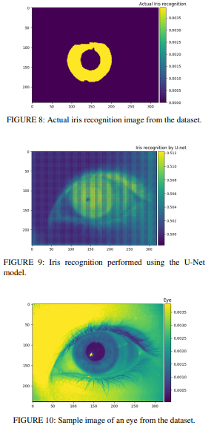
Results: Visualizations
Visual comparisons between original images, ground truth masks, and predicted masks confirm the effectiveness of the U-Net architecture in iris segmentation.

Slide 16
Comparison with Baseline Approaches
The proposed model outperforms traditional methods in both accuracy and computational efficiency, demonstrating robust performance under non-ideal conditions.

Slide 17
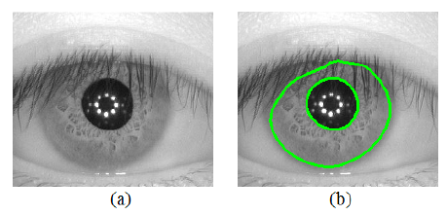
Discussion: Challenges
Challenges include handling occlusion, noise, and varying illumination. The integration of advanced deep learning techniques addresses these issues effectively.

Slide 18
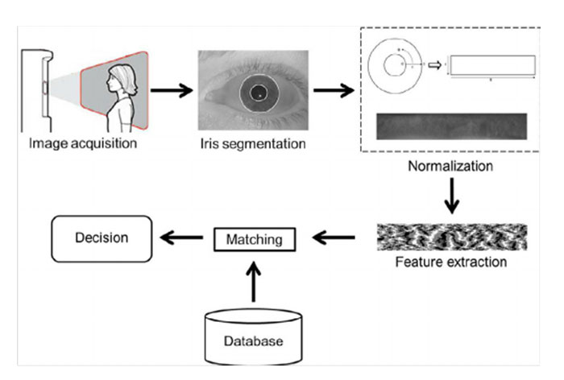
Discussion: Implications
The study highlights the potential of U-Net in real-world biometric applications, offering scalable solutions for secure and efficient identification systems.

Slide 19
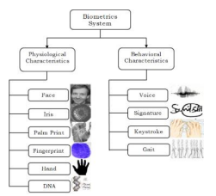
Future Work: Hybrid Systems
Future efforts include combining iris and face recognition for enhanced accuracy and security, enabling multifactor authentication in high-stakes environments.

Slide 20
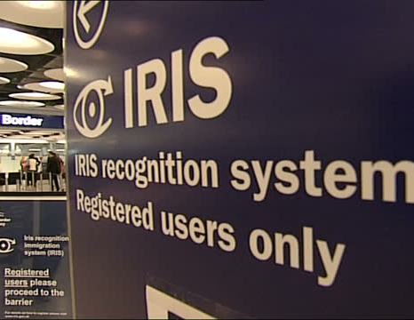
Future Work: Real-Time Applications
Optimizing the model for real-time deployment on resource-constrained devices like smartphones and embedded systems.

Slide 21
Future Work: Dataset Diversity
Expanding datasets to include more diverse demographics and real-world scenarios to improve robustness and fairness across global populations.

Slide 22
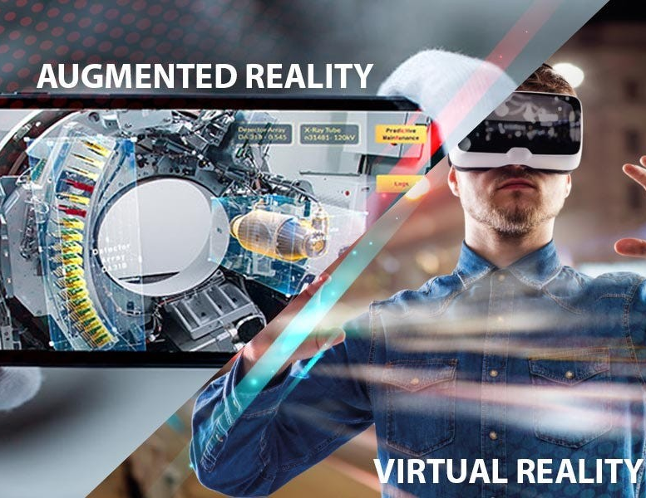
Future Work: AR/VR Integration
Leveraging iris recognition for augmented and virtual reality applications, ensuring secure and personalized user experiences.

Slide 23
Acknowledgment
We express gratitude to Professor Zunnurain Hussain and the University of Management and Technology for their guidance and resources in conducting this research.

Slide 24
Conclusion
The proposed U-Net-based system offers a scalable and accurate solution for biometric identification, emphasizing robustness and adaptability under real-world conditions.

